Slide 1
Mongo DB introduction
„To SQL or NoSQL, that is the query.“

Slide 2
// Relational vs nonrelational database
// Mongodb in short
// Register atlas account
// Define Data Structure / indexes
// CRUD from Mongo SHell
// Aggregation pipeline and compass
// Mongodb university + homework

Slide 3

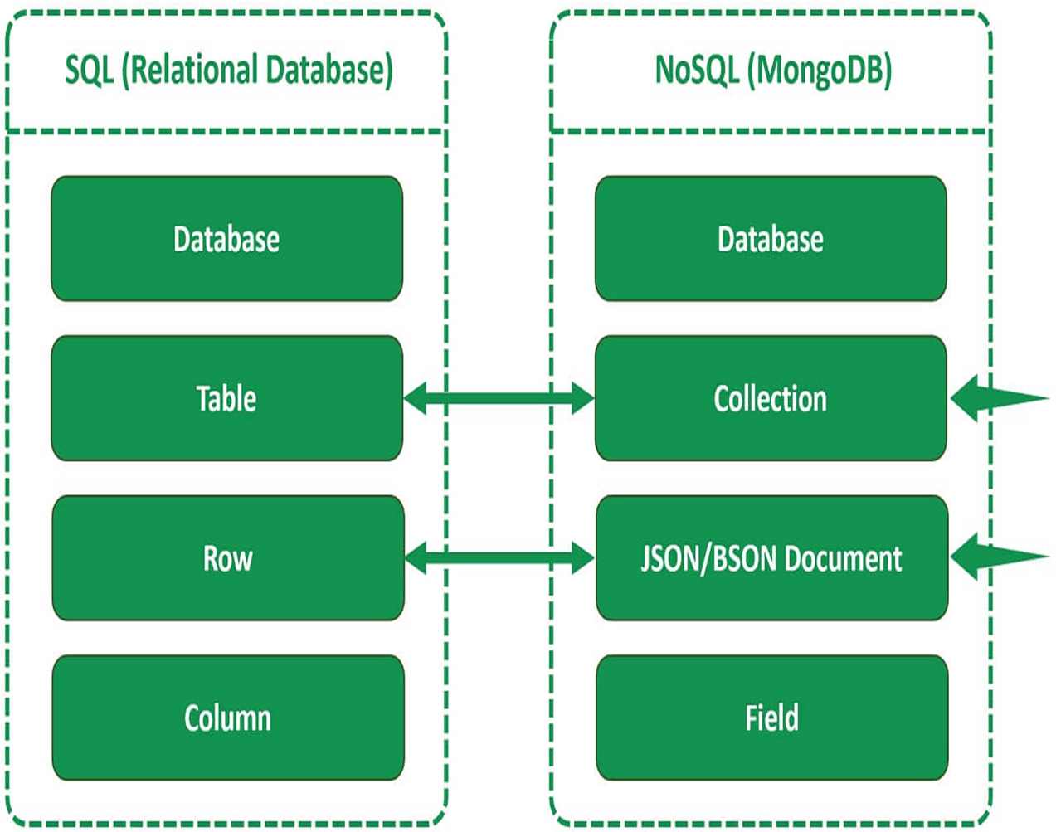

RELATIONAL VS NONRELATIONal DATABASEs

Slide 4
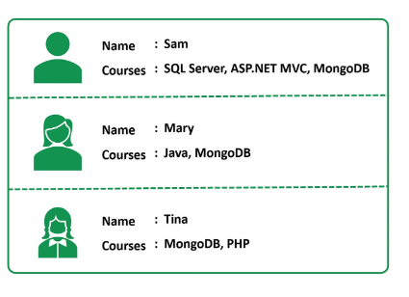
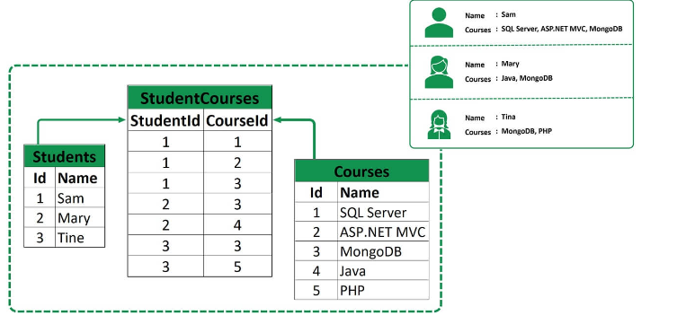
RELATIONAL VS NONRELATIONal DATABASEs

Slide 5
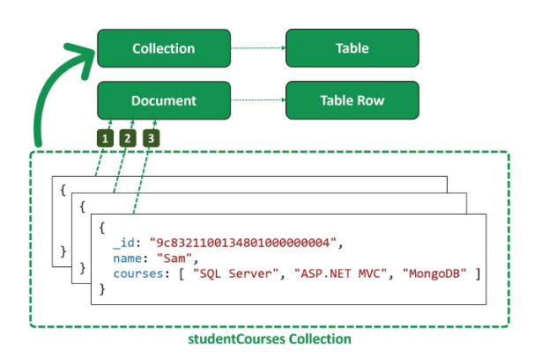
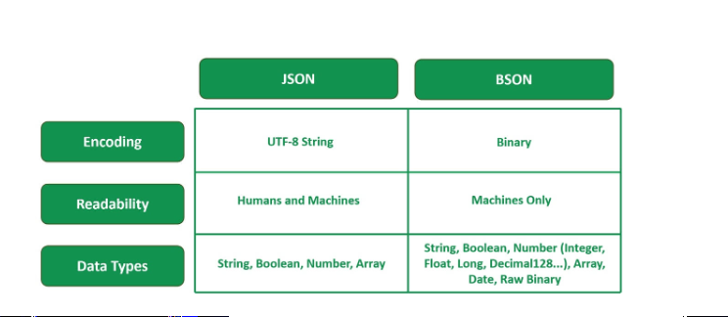
RELATIONAL VS NONRELATIONal DATABASEs

Slide 6
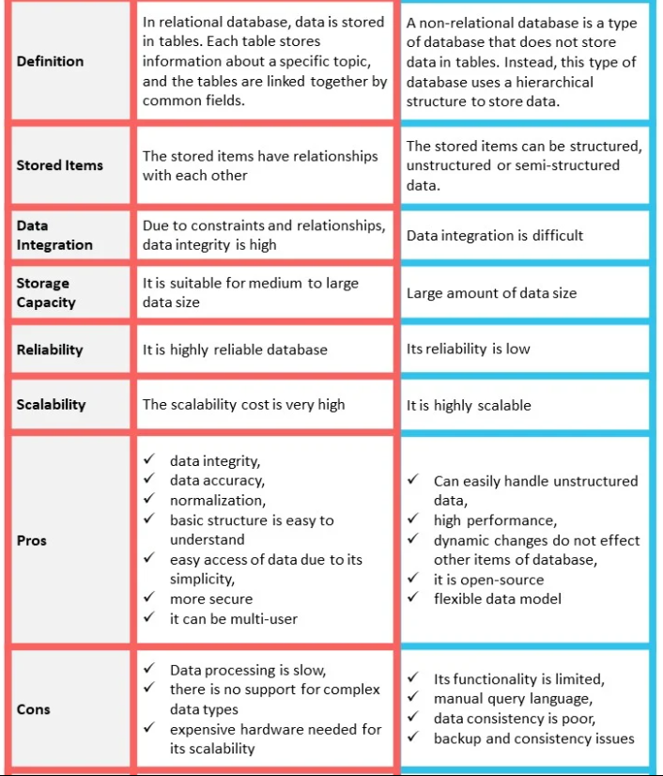
RELATIONAL VS NONRELATIONal DATABASEs

Slide 7

REGISTER ATLAS ACCOUNT
https://www.mongodb.com/cloud/atlas/register

Slide 8

Mongodb compass
MongoDB Shell Download | MongoDB

Slide 9
HOMEWORK
Using aggregation pipeline:
Get a list with all of the books that their authors have the nationality ‘Colombia’.
2. Get a list with all of the books that were published in the last two years. Add a new field to each one called “IsNew” with the value true for those books.
3. Get a list with all of the books that contains the genres “Humor” and “Essay”. For each of these books, the fields “FirstName” and “LastName” will be removed and a new field
“Name” will be added wich will contain both the FirstName and the LastName.

Slide 10
Documentation
https://learn.mongodb.com/courses/start-here-introduction-to-mongodb
https://learn.mongodb.com/courses/mongodb-aggregation
https://learn.mongodb.com/learning-paths/using-mongodb-with-c-sharp
https://www.mongodb.com/docs/
https://www.mongodb.com/try/download/compass

